Slide 1

Non-invasive Measurement of Blood Flow Velocity, Viscosity and Density Using Physics-informed Neural Network
APL745 – Deep Learning for Mechanics Term Project
Instructor: Dr. Souvik Chakraborty and Dr. Rajdip Nayek
Presented by:
Akasapu Hemanthika
2021AIZ8616

Slide 2
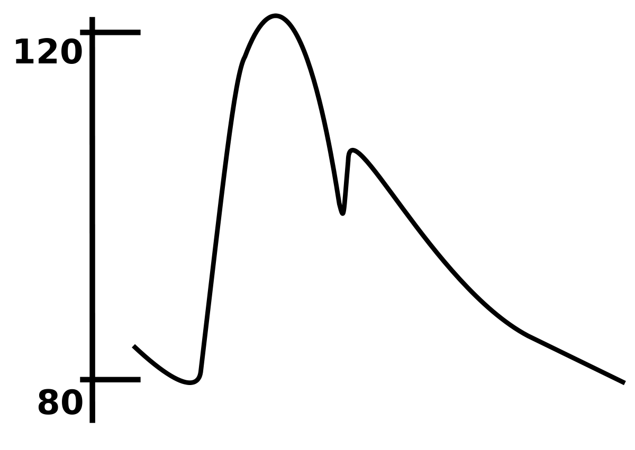
Problem Statement
Non-invasive measurement of blood velocity, viscosity and density
Data used - pressure waveform at a given point in the artery
Blood Pressure Waveform

Slide 3
Motivation
Blood viscosity plays a vital role in the cause of many diseases
Nearly accurate measurement is possible but with invasive methods
Can we measure using any non-invasive method?
Pressure waveform data can be measured using a non-invasive method
Use of this data to achieve a non-invasive measurement of blood viscosity

Slide 4
Project Outline
Defining system physics
System Assumptions
Governing physics laws of the system
Data preparation
Modelling
Loss function definition
training
Results

Slide 5
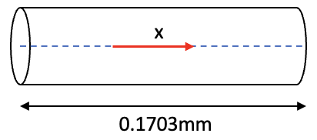
System Assumptions
Non-uniform cross-sectional area artery
Blood
Incompressible
Newtonian
Flows in one direction
Uniform cross-sectional area artery

Slide 6
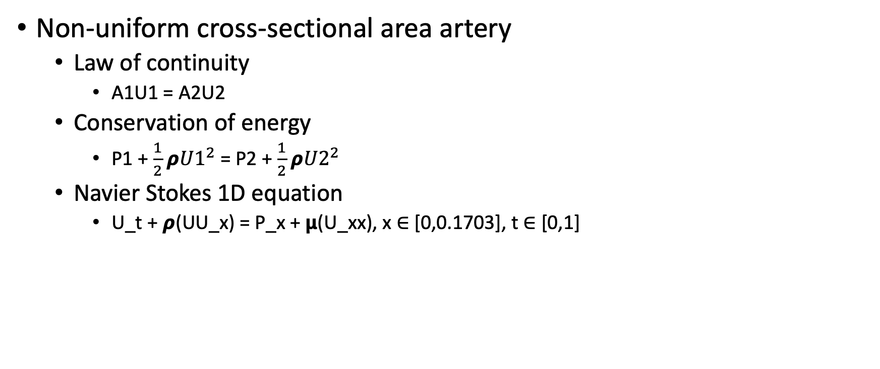
Governing Physics
Non-uniform cross-sectional area artery
Law of continuity
A1U1 = A2U2
Conservation of energy
P1 + $\frac{1}{2}$ 𝞺${U1}^{2}$ = P2 + $\frac{1}{2}$ 𝞺${U2}^{2}$
Navier Stokes 1D equation
U_t + 𝞺(UU_x) = P_x + 𝝻(U_xx), x ∈ [0,0.1703], t ∈ [0,1]
A1, U1, P1
A2, U2, P2
A – cross-sectional area
U – velocity
P – pressure
𝞺 – blood density
𝝻 – blood viscosity
Physics-informed neural networks: A deep learning framework for solving forward and inverse problems involving nonlinear partial differential equations

Slide 7
Data Preparation
Training data at x=0.1 and t=0
Testing data at x=0
Collocation points – generated using numpy random points
0.0
0.1
Paper: Machine learning in cardiovascular flows modeling: Predicting arterial blood pressure from non-invasive 4D flow MRI data using physics-informed neural networks

Slide 8
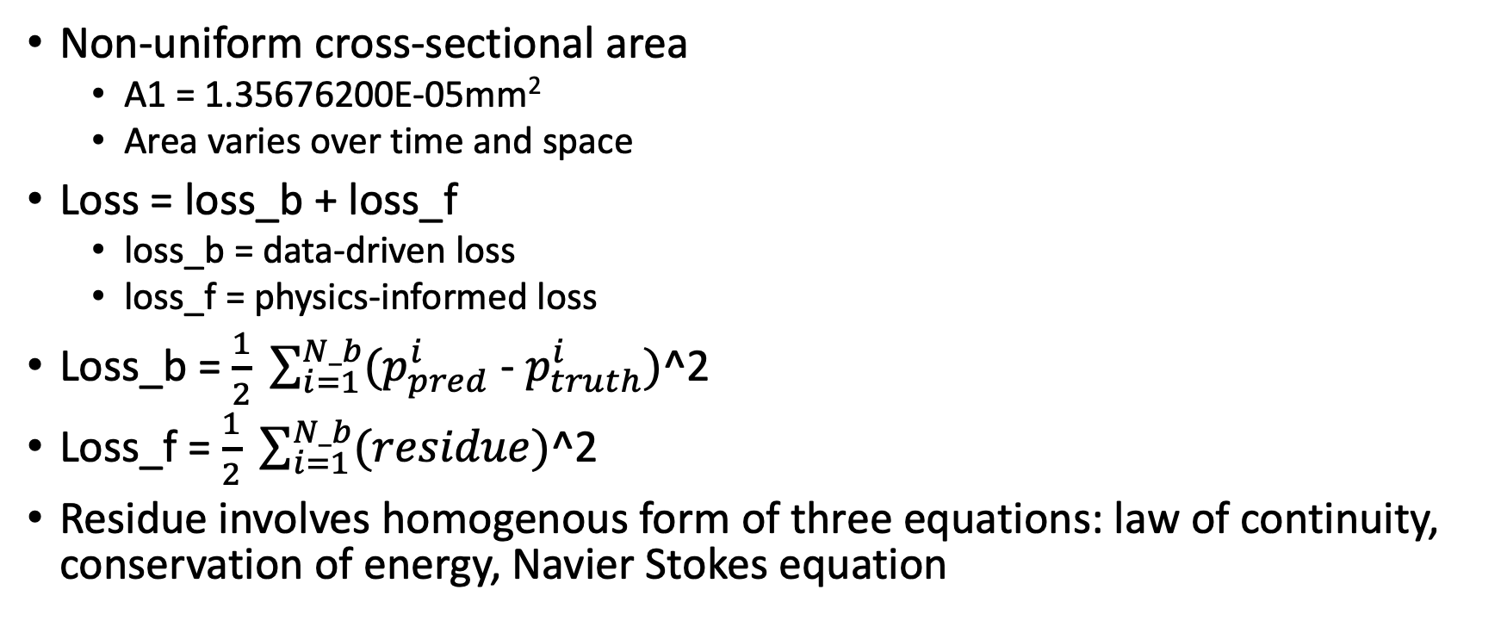
Modelling
Non-uniform cross-sectional area
A1 = 1.35676200E-05mm²
Area varies over time and space
Loss = loss_b + loss_f
loss_b = data-driven loss
loss_f = physics-informed loss
Loss_b = $\frac{1}{2} \sum_{i=1}^{N_b}{(p_{pred}^{i}}$ - $p_{truth}^{i})$^2
Loss_f = $\frac{1}{2} \sum_{i=1}^{N_b}{(residue})$^2
Residue involves homogenous form of three equations: law of continuity, conservation of energy, Navier Stokes equation

Slide 9
Training
Optimizer - Adam
Labelled data - 200 data points
Collocation data - 5000 data points
lambda1 and lambda2 initialization - 1060, 3.5
Epochs - 20000 with learning rate 1e-3
Model layers = [2, 100, 100, 100, 100, 100, 100, 100, 3]

Slide 10
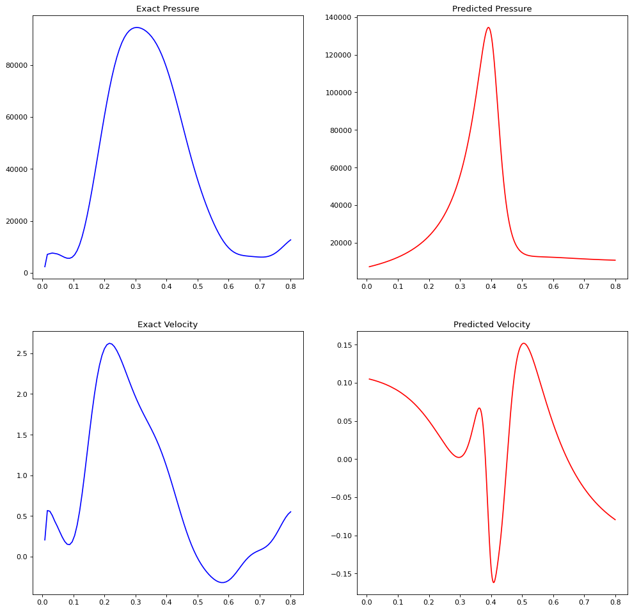
Results
The model is able to capture non-linearity but the results are not accurate.

Slide 11
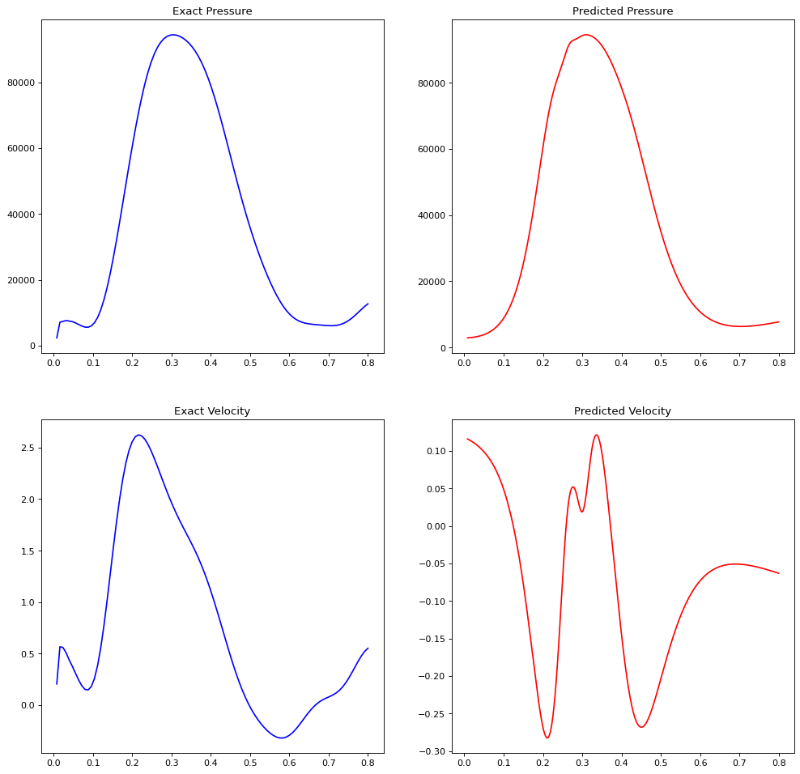
Results
When trained for more epochs, high overfitting is observed
The model was able to predict pressure but very poorly performed on predicting velocity

Slide 12
Summary
Though training has been done for many iterations and hyperparameters the model is not able to generate a decent result
The reason for this unusual result may be due to the lack of proper definition of system physics
The code of the project is hosted on GitHub at https://github.com/AHemanthika/BloodViscoVelocityPINN
References:
[1] Raissi, M., Perdikaris, P., & Karniadakis, G. E. (2019). Physics-informed neural networks: A deep learning framework for solving forward and inverse problems involving nonlinear partial differential equations. Journal of Computational physics, 378, 686-707.
[2] Kissas, G., Yang, Y., Hwuang, E., Witschey, W. R., Detre, J. A., & Perdikaris, P. (2020). Machine learning in cardiovascular flows modeling: Predicting arterial blood pressure from non-invasive 4D flow MRI data using physics-informed neural networks. Computer Methods in Applied Mechanics and Engineering}, 358, 112623.
THANK YOU

